Slide 1
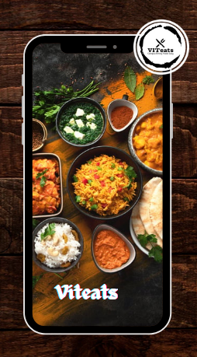
Viz-bees 1. Siddhartha Pathak – 21bce3930 2. Aditya kumar jha – 21BCE3759 3. Aniket kumar shah – 21bce3767 4. Ayush kumar thakur – 21bce3771

Slide 2
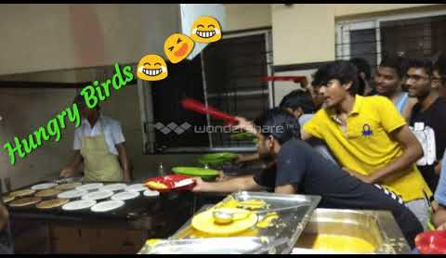
Introducing VITeats
Are you tired of wasting precious time standing in endless queues at the paid mess?
The solution for hassle-free dining on campus. Say goodbye to long waits and hello to convenience with our innovative app. Order your meals in advance, whether it's a quick snack or a hearty meal, and breeze past the queues. Simply present your QR code at the mess, and your freshly prepared meal will be waiting for you.

Slide 3
Solution Efficient Pre-ordering: VITeats enables students to pre order meals via a mobile app, eliminating the need to wait in long queues at the paid mess. Swift Order Pickup: With a QR code system in place, VITeats ensures quick and efficient order pickup, reducing wait times and stress for students. Real-time Updates: Students receive real-time updates on their orders, enhancing transparency and allowing for better planning of study schedules. Feedback Mechanisms: VITeats incorporates feedback mechanisms to gather student input, ensuring continuous improvement and addressing any concerns promptly.
Problem
The project aims to address the issue of long queues at the paid mess, which often disrupts students schedules and impacts their productivity, especially during peak times such as exam seasons.

Slide 4
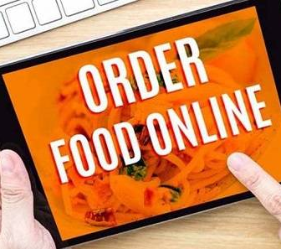
SOCIAL IMPACT
Streamlined Dining Experience: VITeats enables pre-ordering meals, eliminating long queues and reducing stress.
Enhanced Student Satisfaction: Convenience and more study time leads to increased satisfaction among students.
Improved Academic Performance: Reduced stress and increased study time likely improve academic outcomes. Promotion of Campus Well-being: VITeats contributes to a healthier and more productive campus environment.
Demonstration of Technological Innovation: Implementation showcases the university's commitment to leveraging technology.
Enhancement of University Reputation: VITeats enhances the university's reputation by focusing on student satisfaction and technological advancement.

Slide 5

Business model

Slide 6
Cost Structure Development and Maintenance: Allocate resources for website development, design, programming, and ongoing maintenance. • Operational Costs: Cover expenses related to food procurement, storage, preparation, utilities, and staff salaries. • Marketing and Advertising: Budget for marketing campaigns, promotional materials, and advertising placements to reach the target audience effectively. • Technology Infrastructure: Invest in reliable hosting services, cloud storage, cybersecurity measures, and software licenses. Customer Support: Allocate resources for hiring and training customer support staff to assist users with inquiries and technical issues. Revenue Streams • Transaction Fees: Apply a small transaction fee for each order placed through the website to cover payment processing cost. Sensitive Add-ins • Advertising Revenue: Generate revenue through advertising partnerships with local businesses or food vendors targeting college students.

Slide 7
Key Partnerships Food Suppliers: Partner with local food suppliers to ensure a steady supply of fresh ingredients for the mess. Payment Processors: Collaborate with payment processing companies to securely handle online transactions and manage student account balances. Advertisers: Form partnerships with local businesses or food vendors for advertising placements on the website or app. College Administration: Work closely with college administrators to align the digital mess service with campus policies and regulatiors Key Resources Digital Platform Menu Management System: Payment Gateway Customer Segments College Students: Primary users who benefit from the convenience and variety of the digital mess service. Mess Owners/Administrators: Secondary users responsible for managing menu items, orders, and finances through the platform.

Slide 8
Key Activities: Menu Planning and Management: Collaborate with mess owners to plan daily menus, update menu items, and ensure availability. Marketing and Promotion: Develop marketing strategies to attract new students to the digital mess service and increase engagement among existing users. Technology Development: Continuously update and improve the digital platform to enhance user experience, security, and functionality. Operational Management: Monitor food procurement, storage, preparation, and distribution to ensure smooth operations and customer satisfaction.

Slide 9
Value Proposition: Convenience: Provide students with a convenient and efficient way to access and order meals from the college mess without having to wait in long queues Variety: Offer a diverse menu selection with options for breakfast, lunch, and dinner to cater to different tastes and dietary preferences. Budget-Friendly: Allow students to manage their meal expenses effectively with a prepaid monthly subscription model and affordable pricing Digitalization: Digitize the mess operations to streamline processes, reduce wait times, and improve overall efficiency for both owners and students.

Slide 10
Channel: The primary channel would be the website itself, where students can place orders, check menus, provide feedback, and access other relevant information. Mess owners can also use this channel to manage inventory, update menus, and track orders.

Slide 11
Competitor Analysis: As of now there is no such competition for this problem. There was a mobile app initially “Proddle Mess” but that is not in use these days as it was not scaled efficiently and addition to that it was only for a particular mess, and we want to develop a solution for all the paid messes in the VIT.

